Slide 1


Child of One
"It starts with a kiss, it ends with a baby.“
Quebec proverb
It’s important to sexually educating our children
August 17, 2020
Ayiti Analytics final project
Cohort march-august 2020

Slide 2
Context
In Haiti's poor neighbourhoods, many girls drop out of school because of premature or unwanted pregnancies. Some have had the support of the father of their children to raise them or of their parents, Others do not, some do not know the identity of the father because 40% of these pregnancies are due to rape and sexual abuse, so they have to raise their children alone. These young teenage girls between the ages of 12 and 19 years old make all kinds of activities and sacrifices to provide for their children, many go into the informal sector trade, some go into domestic work as housekeepers, and some go into prostitution in the hope of having enough to feed themselves and their children.
Are haitian children sexually educated?
Does a teenager mom have the same choice of futur with other teenager in Haiti?

Slide 3
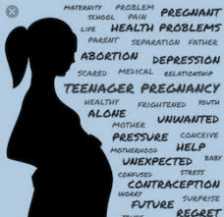
Background
For every 1000 girls between the ages of 15 and 19, 66 have at least one early pregnancy in Haiti
Under the effect of certain variables such as rape early union, early sexuality, and under-use of contraception

Slide 4
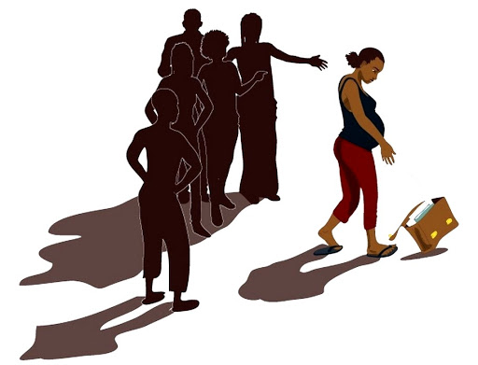
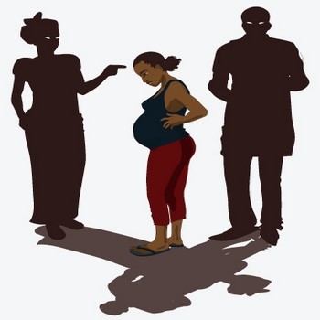
Problem
- Dropping out of school
- Marginalization
- Perpetuation of women's low status and poverty
This consequences of early pregnancy, is the problem that our project want to try to find a solution for

Slide 5



Audience
All young mothers
NGOs working with and for young people, women
Corporate philanthropy

Slide 6


Data
https://dhsprogram.com/topics/Youth-Corner/haiti-dhs-key-indicators.cfm
https://data.humdata.org/dataset/777e8b06-337f-4295-80bc-ca1515244215

Slide 7
Methodology
Web scraping
Data cleaning
Data analysis
Conclusion
Analysis of keys variables
Notes:
Explain each cell

Slide 8
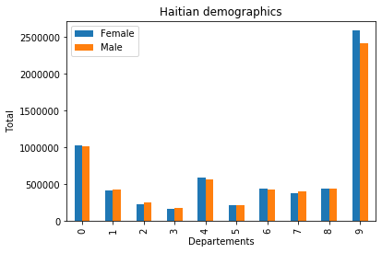
Haitian demographics
Haiti have 10 departments:
0 : Artibonite
1 : Centre
2 : Grande'Anse
3 : Nippes
4 : North
5 : North-East
6 : North-West
7 : South
8 : South-East
9 : West
The three departments with the largest population are respectively (in descending order): West, Artibonite and North. So they're the three with the most young people aged between 15 and 24 years old.(21% of population)

Slide 9
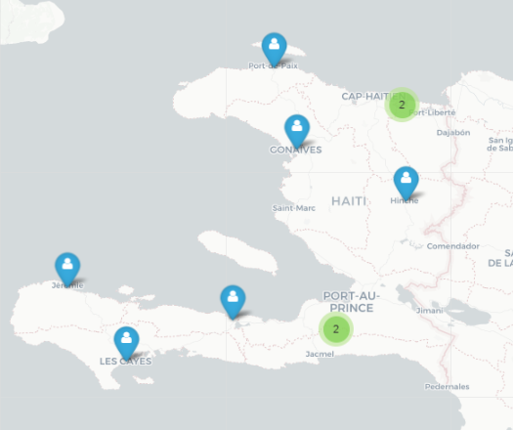
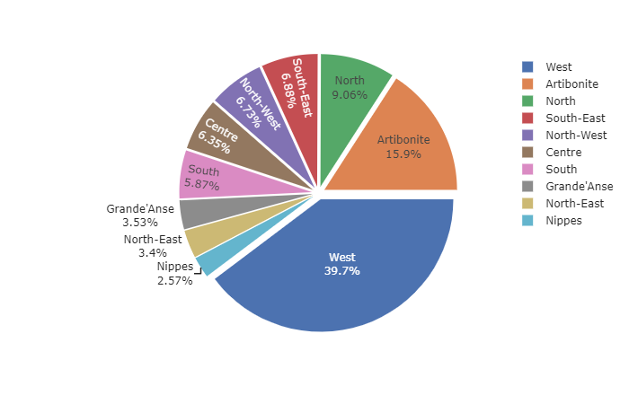

Slide 10
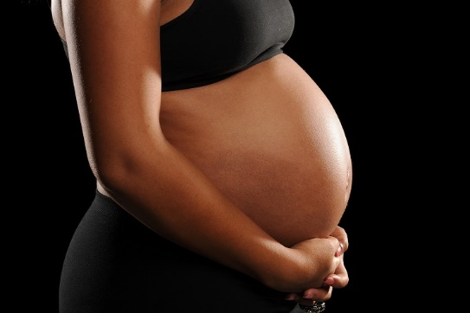
Teenage pregnancy

Slide 11
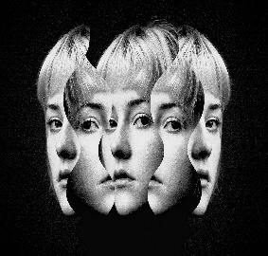
Keys variables
Variables used are percentage of youth :
who cannot read
with completed primary education
exposed to at least one media source at least once
a week
currently married
currently living together
who had sexual intercourse before age 15
who had sexual intercourse before age 18
who have begun childbearing
who have ever been pregnant
currently using a modern contraceptive method
who are sexually active and have ever used any contraceptive method
who have had sexual intercourse and who say that their first experience was against their will
That treats different age groups: 15-19 years old, 15-24 years old, 20-24 years old…

Slide 12
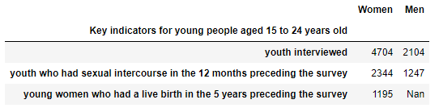
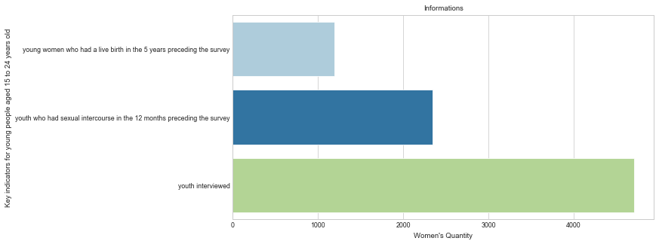
Dataset

Slide 13
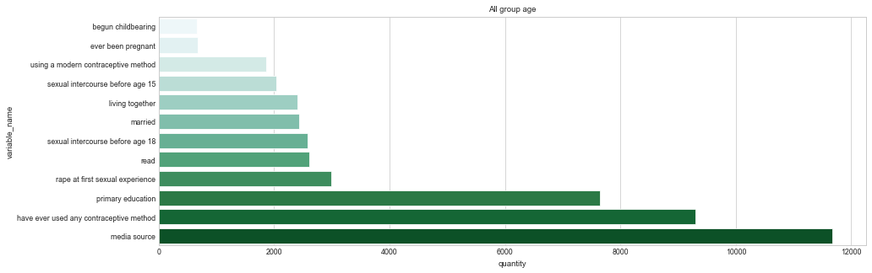
All age group
This chart shows that it's the young people most exposed to the media who have an early pregnancy.

Slide 14
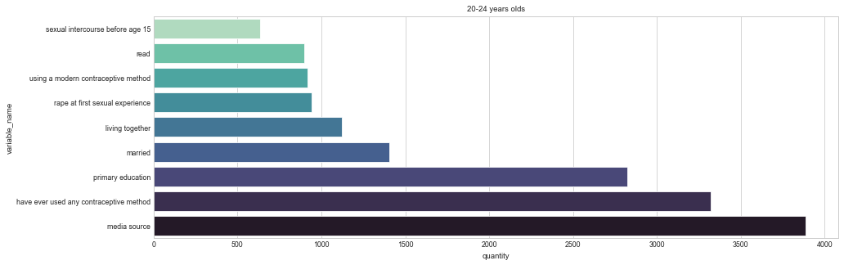
20-24 years old
It’s same for group aged between 20 and 24 years old, it's them most exposed to the media who have an early pregnancy.

Slide 15
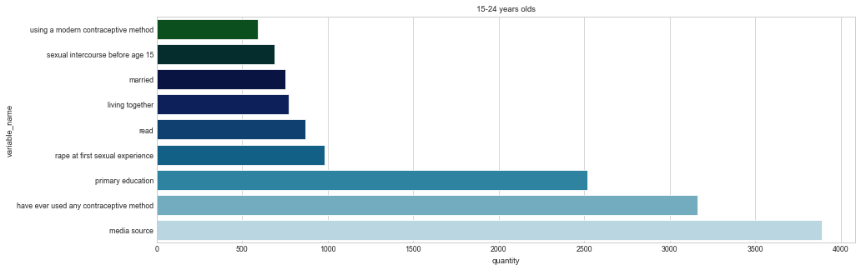
15-24 years old
This chart shows that more the young people most exposed to the media more he have chance to have an early pregnancy.

Slide 16
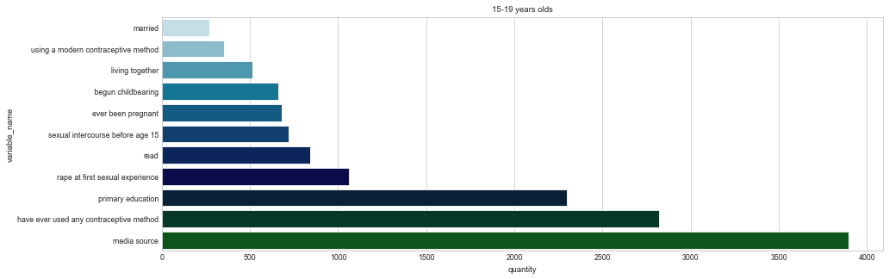
15-19 years old
For group aged between 15 and 19 years old, it's them most exposed to the media who have an early pregnancy, follow by the percentage of sexually active youth who have ever used any contraceptive method

Slide 17

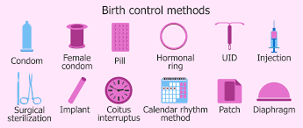

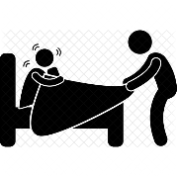
Exposure to the media
Use of contraceptive methods
Complete primary school education
Rape at first sexual experience
There's no parental control
The majority of adolescents are unaware of or do not use contraception.
The four key factors that predominate across all age groups.
Early pregnancy is three times higher among girls with no education(27%) than among those with high school education or above (9%)
They don't know when to say no, they're not protected.

Slide 18
Discussions
only 12% of sexual information is provided by family and 29% by friends;
the average age at first sexual intercourse is 13;
3% of teenage girls have already had 3 children;
only 16% of the progenitors are adolescents and 47% are over 28 years of age;
93% of adolescent girls do not use condoms or use them only sometimes;
90% do not know about family planning methods and how they work;
92% do not know their menstrual cycle and 88% do not know their fertile period

Slide 19

Abstract
60% of haitian population aged between 15 and 65 year olds. On every 1000 girls between the ages of 15 and 19, 66 have at least one early pregnancy . Adolescents between the ages of 10 and 19 make up about 22% of the population.
So it’s important to do sexuality education of the children because a girl's pregnancy can radically change her life. She may be forced to drop out of school, reducing her employment prospects. She also becomes more vulnerable to poverty and exclusion. Her health can also suffer, as complications related to pregnancy.

Slide 20
Solutions
The Ministry of Education and Vocational Training should integrate ‘sex education’ as a specific course in the academic curriculum. Not just for secondary school, but all three levels of formal education. Sexuality education consists of information about sexuality and the transmission of a number of values and recommendations. It begins in childhood and continues to some extent throughout life. It may include the expression and discussion of feelings of love, sexual practices, sexual and reproductive health, consent and mutual respect.
What about teenagers who are already mothers?
An educational reintegration program should be set up for them, which will be parallel to a program of odd jobs conditional on prior training which they will have received in relation to the educational level they have reached before giving birth.

Slide 21
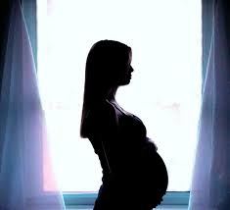
Haiti have a young age structure, it would not be wise to neglect teenage mothers in this way. Adolescent pregnancy is usually less a deliberate choice than a lack of choice: it is the consequence of little or no access to education, information and health care. Take care of them

Slide 22
References & Appendices
Link of the project’s GitHub repository: https://github.com/Maickery/Child_of_change

Slide 23





Maïckery Bozor
Accounting,
ASL interpreter to be,
Data Analyst to be.
+509 48302636
maickerybozor@gmail.com
Maickery Bozor
@mai_ckery
Thanks you ladies and gentlemen for your attention !

